Slide 1
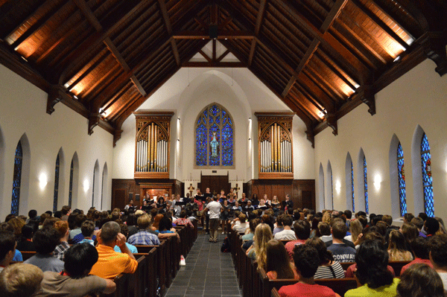
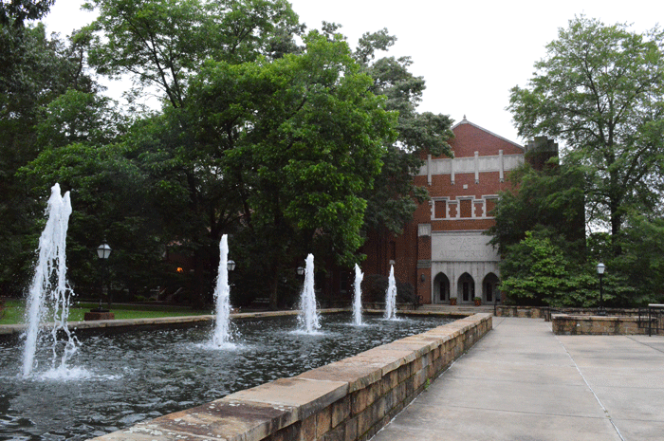

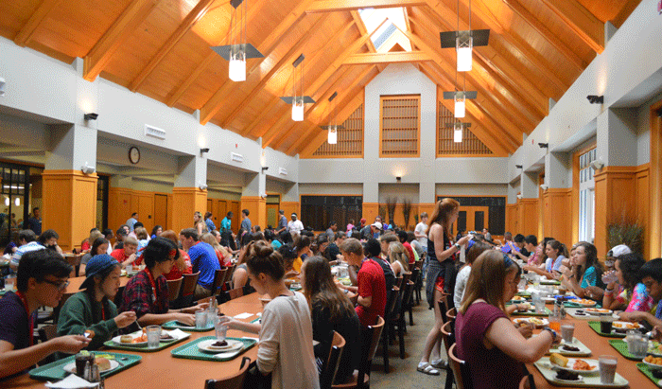
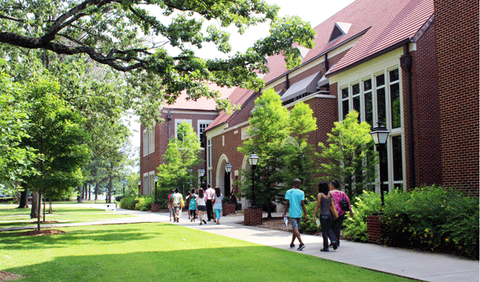


Slide 2
Arkansas Governor’s School
Sunday, June 11, 2017
through
Saturday, July 22, 2017
(mid-session break over July 4th weekend)
Hendrix College
Conway, Arkansas

Slide 3
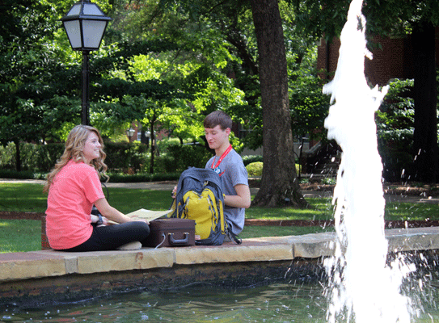
What is AGS?
400 of the best and brightest rising seniors
6-week residential program
No cost, no grades, no tests!
Held annually since 1980
Over 80 faculty and staff
Approximately 15,000 alumni
Students nominated to apply by high school teachers and counselors
Applications reviewed by state committee

Slide 4
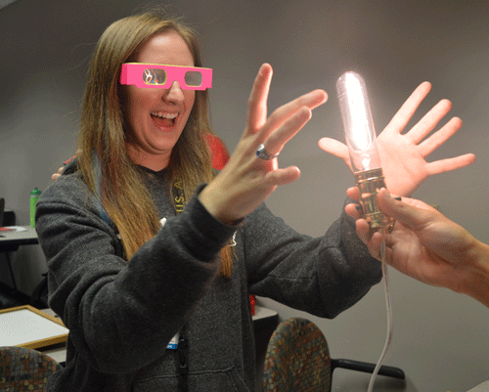
Ideal Student has:
High intellectual potential
Outstanding ability in an academic or artistic area
Evidence of giftedness
Creativity
High motivation
Social, emotional, and intellectual maturity

Slide 5
Curriculum – Area I
Special Aptitude Development
Arts (*require audition video)
  Drama
  Choral Music
  Instrumental Music
  Visual Arts
Academics
  English/Language Arts
  Mathematics
  Natural Science
  Social Science
Students must apply in at least one (1) Area I discipline but may choose to apply in up to two (2). Students are selected to study in one (1) Area I.
Past course descriptions are on our website at https://www.hendrix.edu/ags/ags.aspx?id=23218

Slide 6
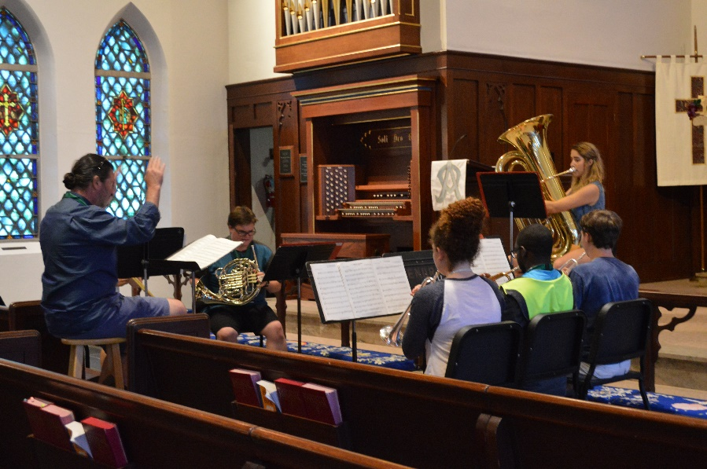
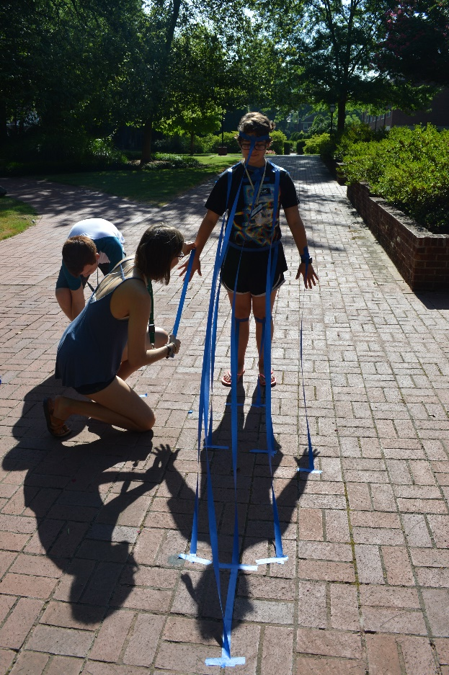
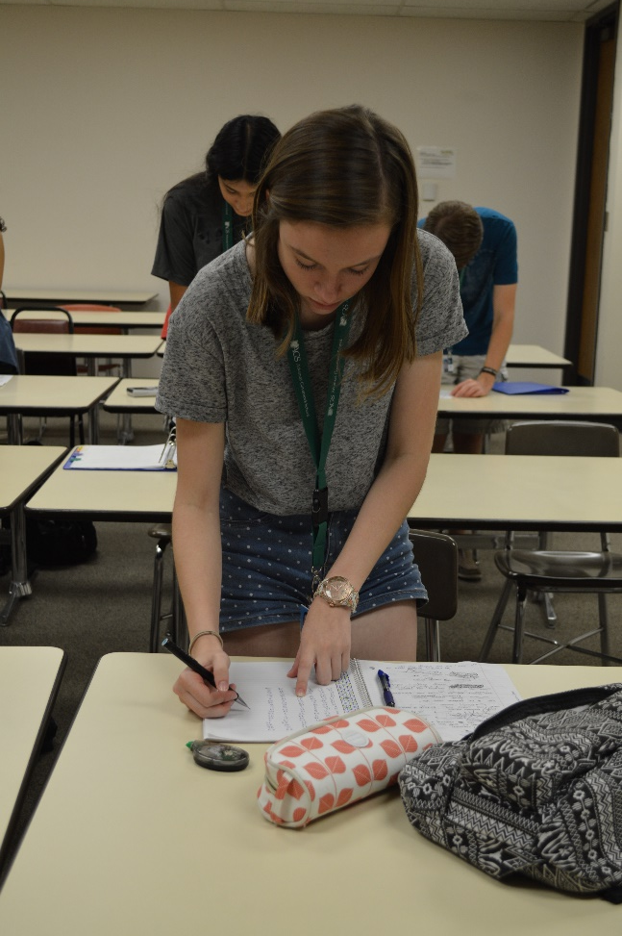
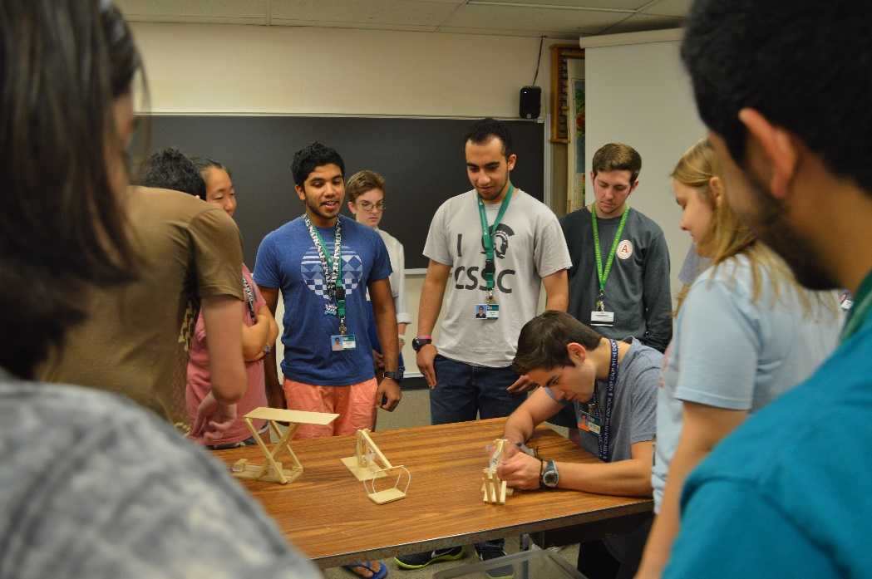
Instrumental Music
Visual Arts
Math
Natural Science

Slide 7
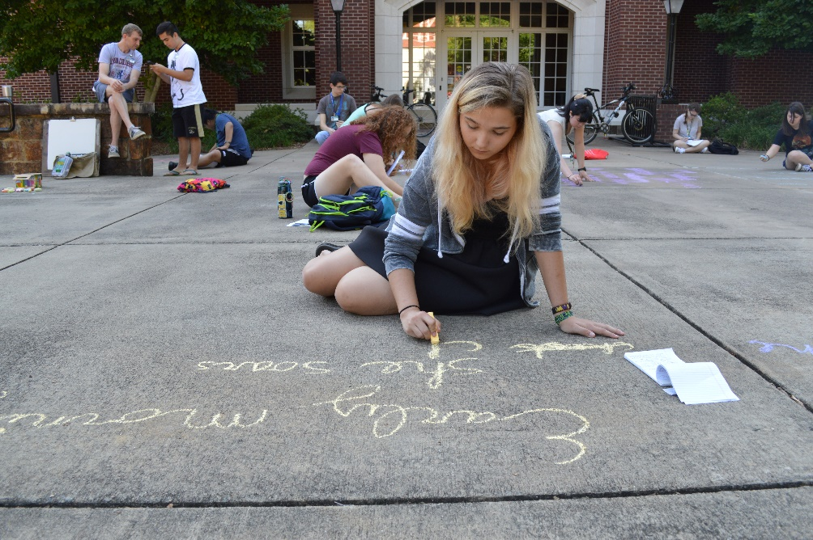
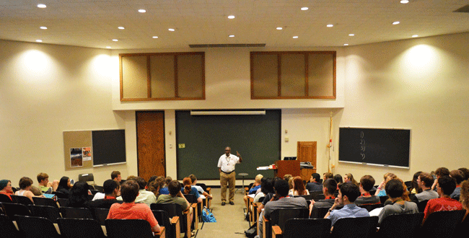
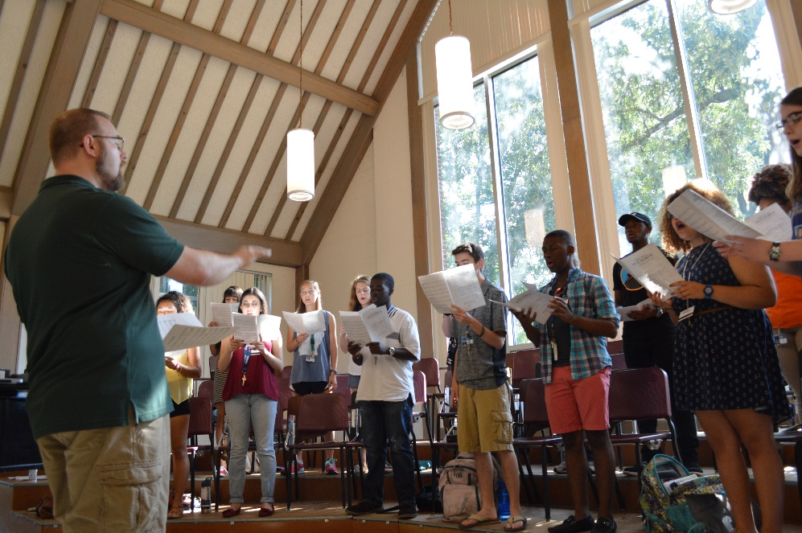
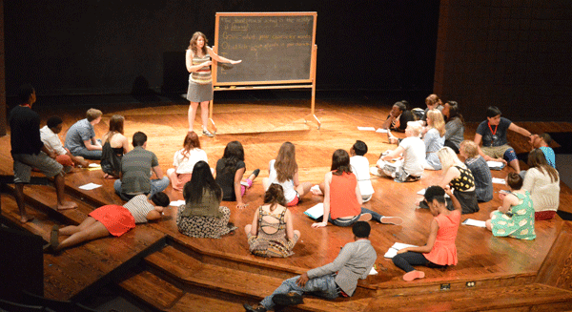
English/Language Arts
Social Science
Choral Music
Drama

Slide 8
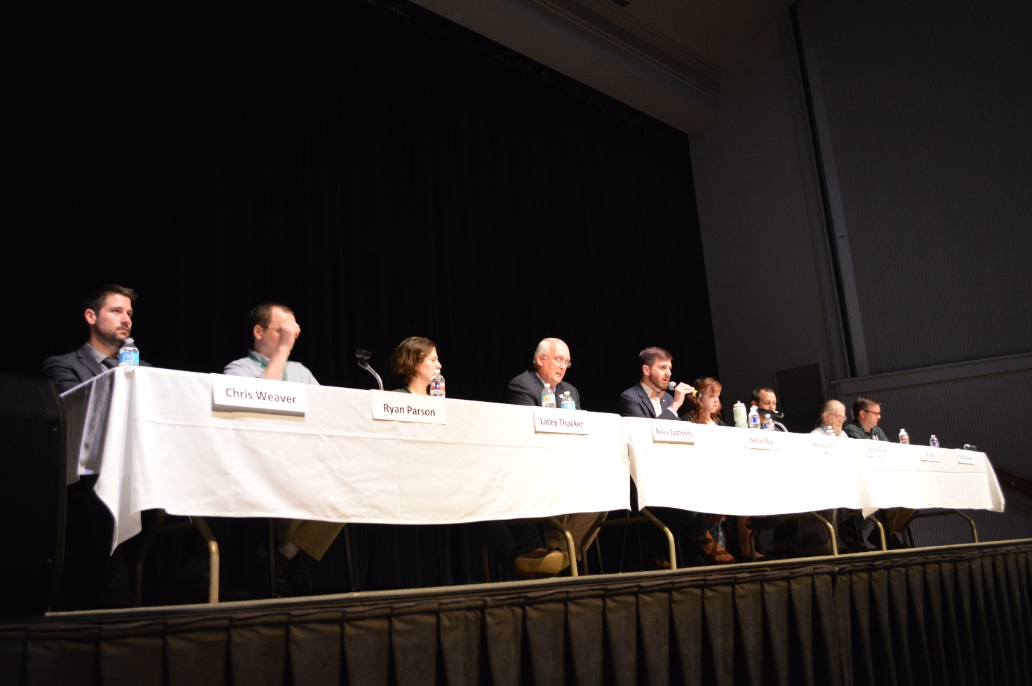
Curriculum – Area II
General Conceptual Development
Focuses on critical thinking
  Logic
  Philosophy
  Evidence-based opinions
  Civil Discourse
Brings together students from all eight Area I disciplines
Draws on films, speakers, and readings for discussion

Slide 9
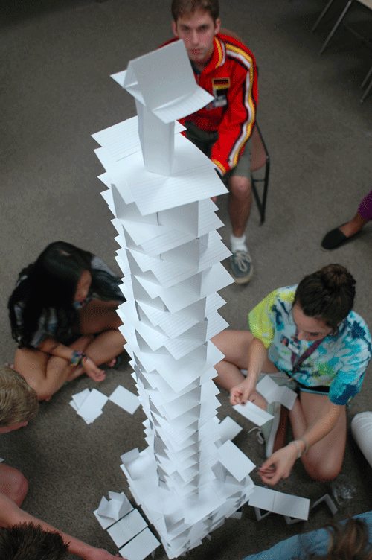
Curriculum – Area III
Personal and Social Development
Foster personal and social development necessary to benefit fully from AGS
Personal Evaluation and Potential
  Personality/Bias tests
Interpersonal Communication
  Face-to-face interaction
  Conflict and stress management
Psychology and Sociology
Civic Responsibility
Brings together students from all eight Area I disciplines

Slide 10
Typical Day at AGS
3 or 4 classes during the day
  1 or 2 classes in the morning
  1 or 2 classes in the afternoon
1 or 2 classes Saturday morning
Tuesday/Thursday special guest speakers
  Go to www.hendrix.edu/ags/guestspeakers/ for bios
Thursday evenings required films

Slide 11
Typical Day at AGS
4:10/6:10 optional seminars every weekday
Library and computer lab hours
Film series, discussion/book groups, field trips, music groups
Social and Recreational Activities
  Dances, open mic nights, concerts, games
  Soccer, flag football, ultimate frisbee, softball, pool games
Past Weekly Activities Schedules available on our website at https://www.hendrix.edu/ags/ags.aspx?id=23162

Slide 12
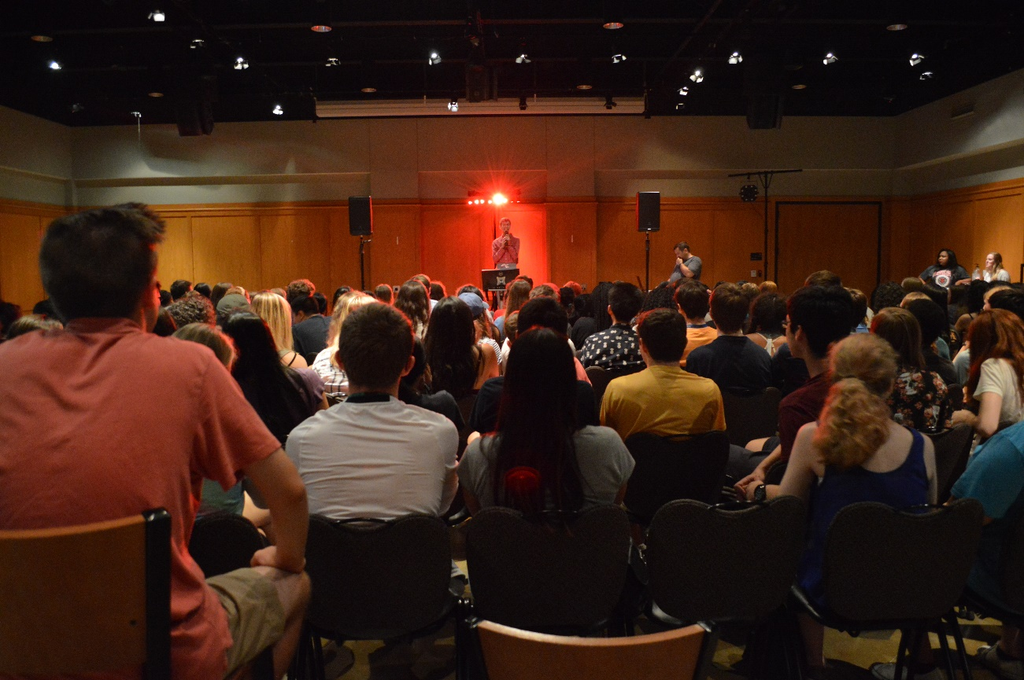
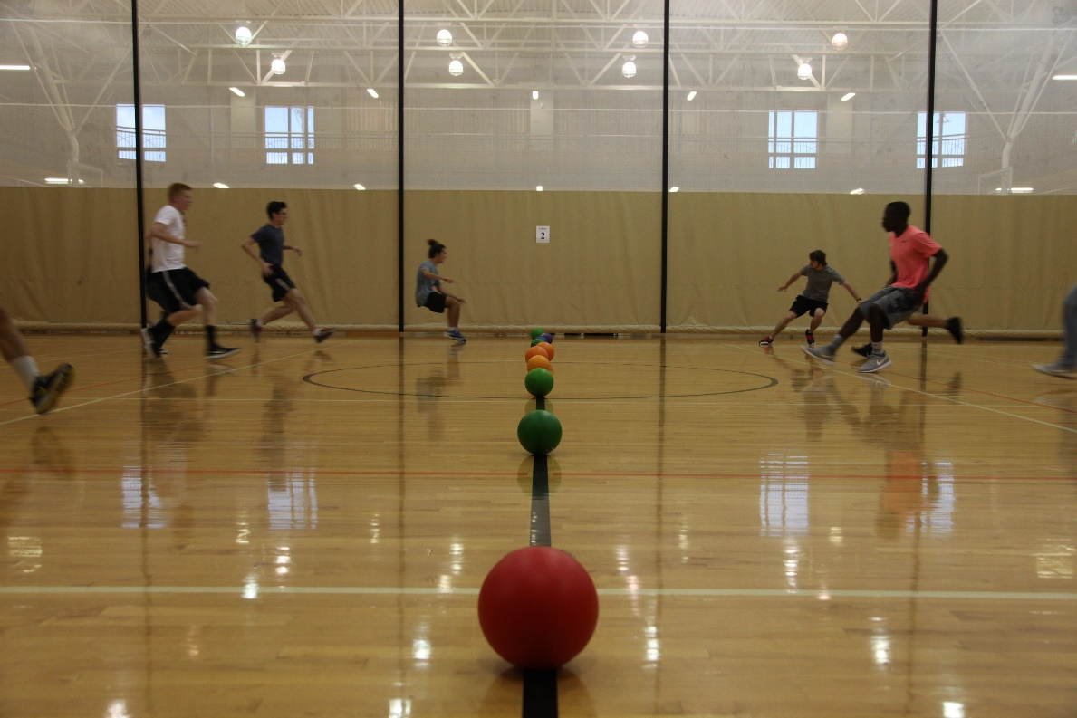
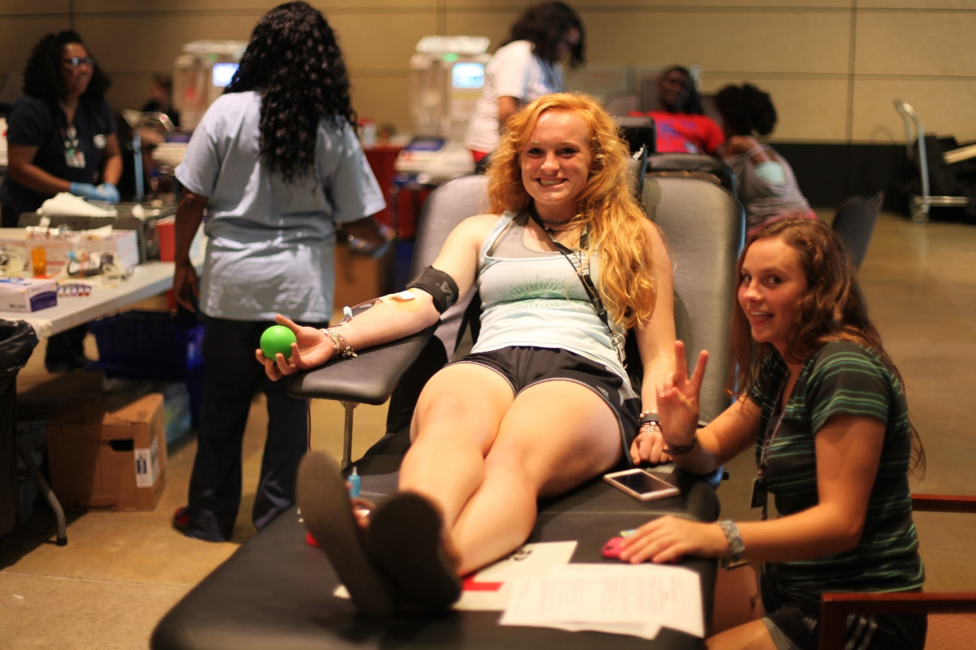
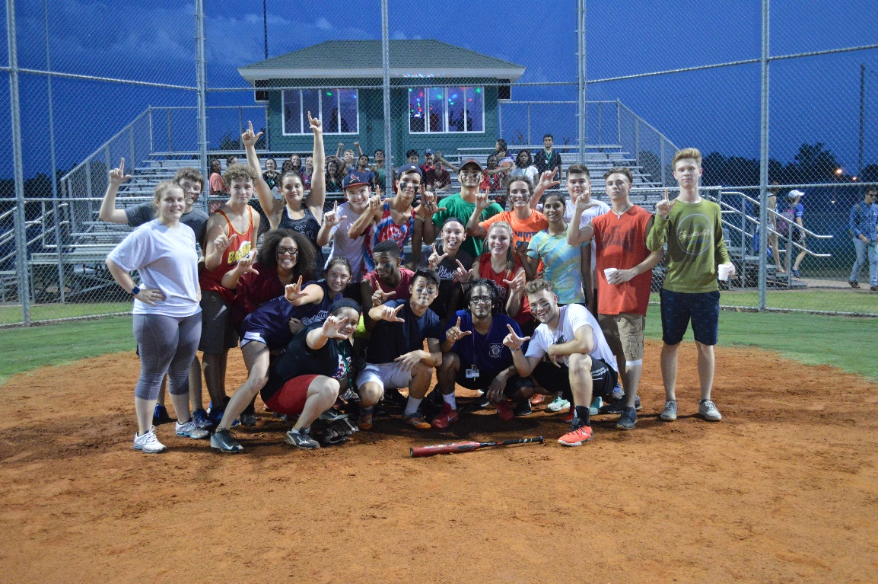

Slide 13
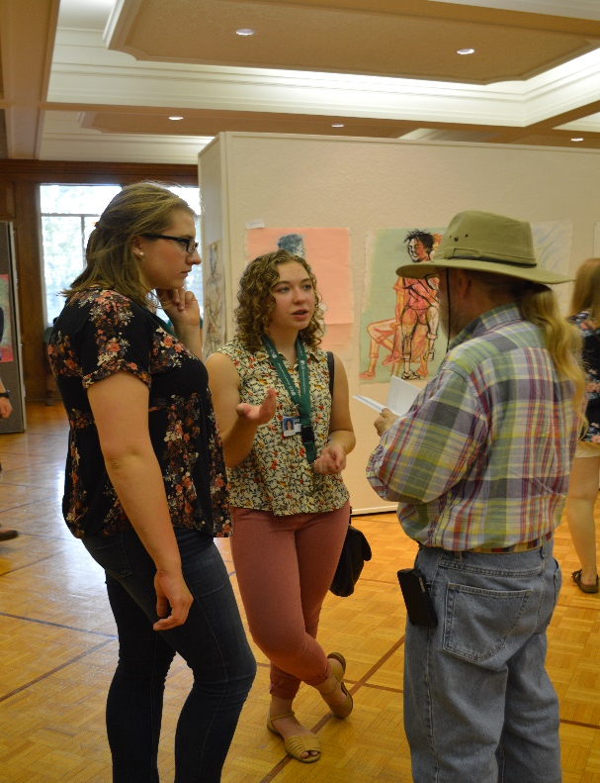
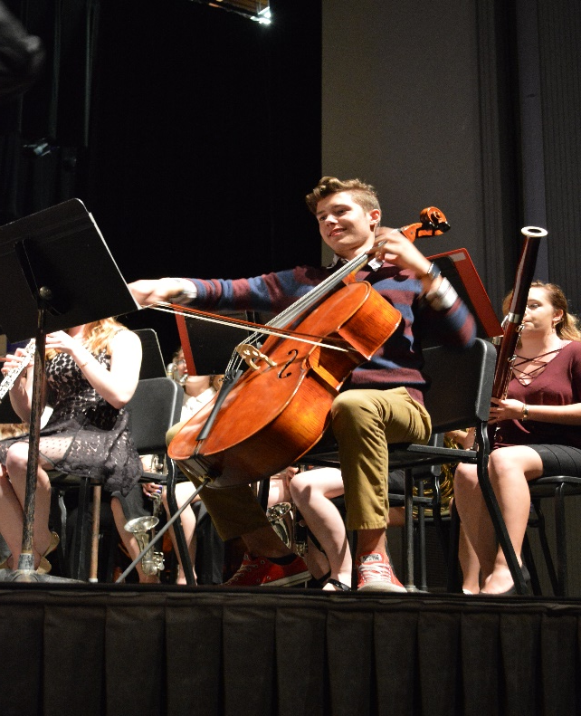
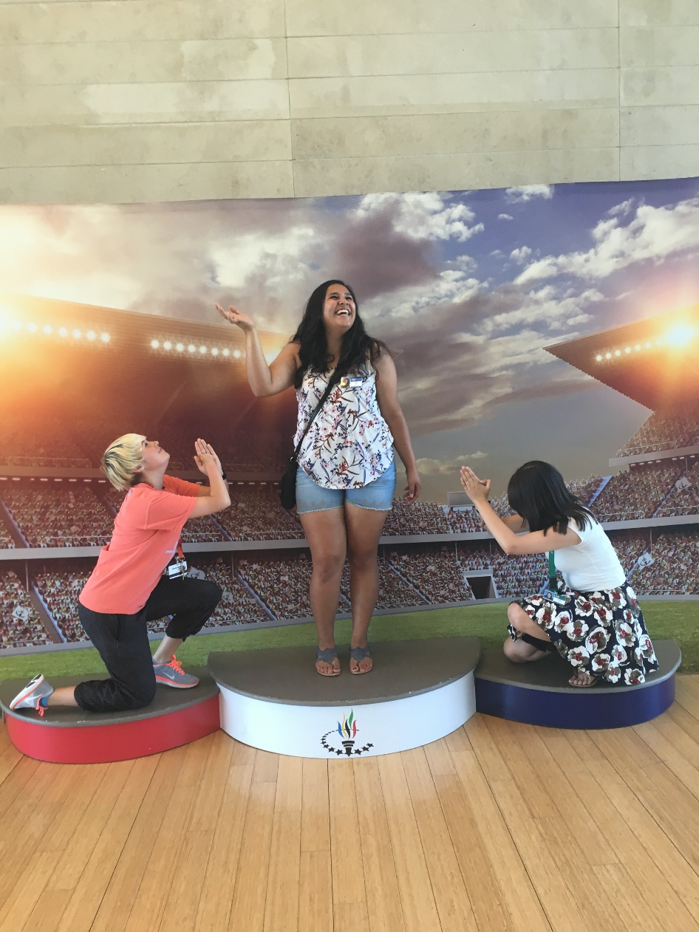
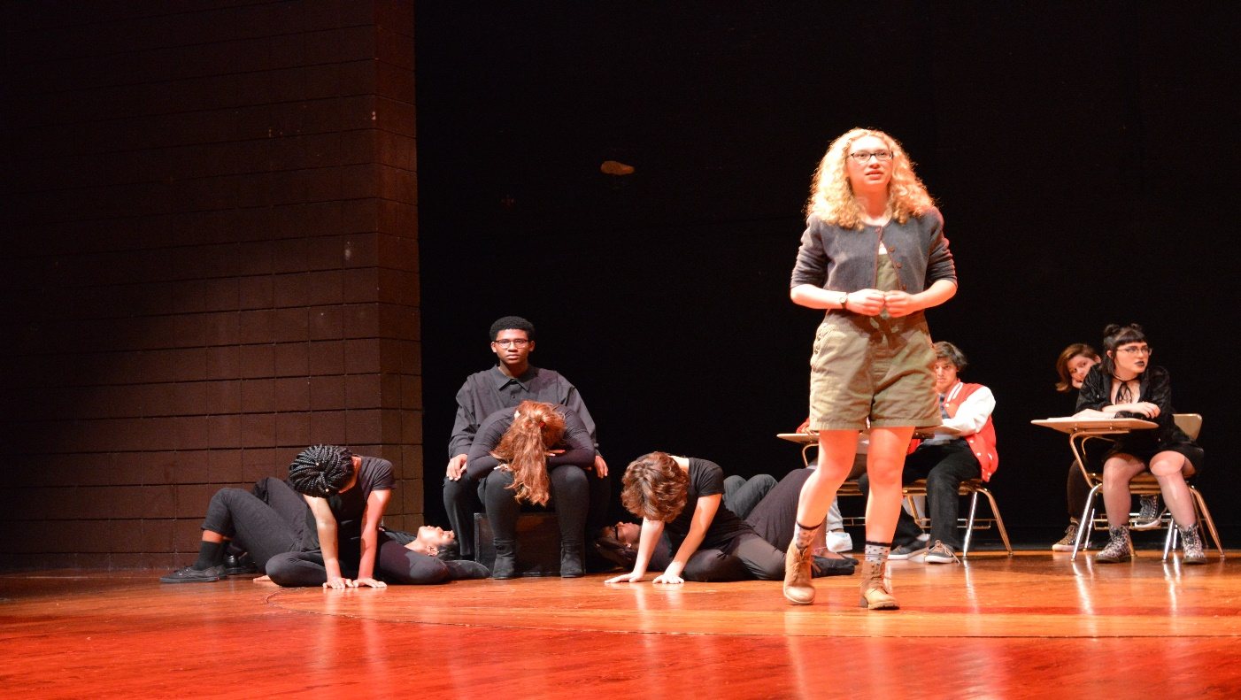

Slide 14
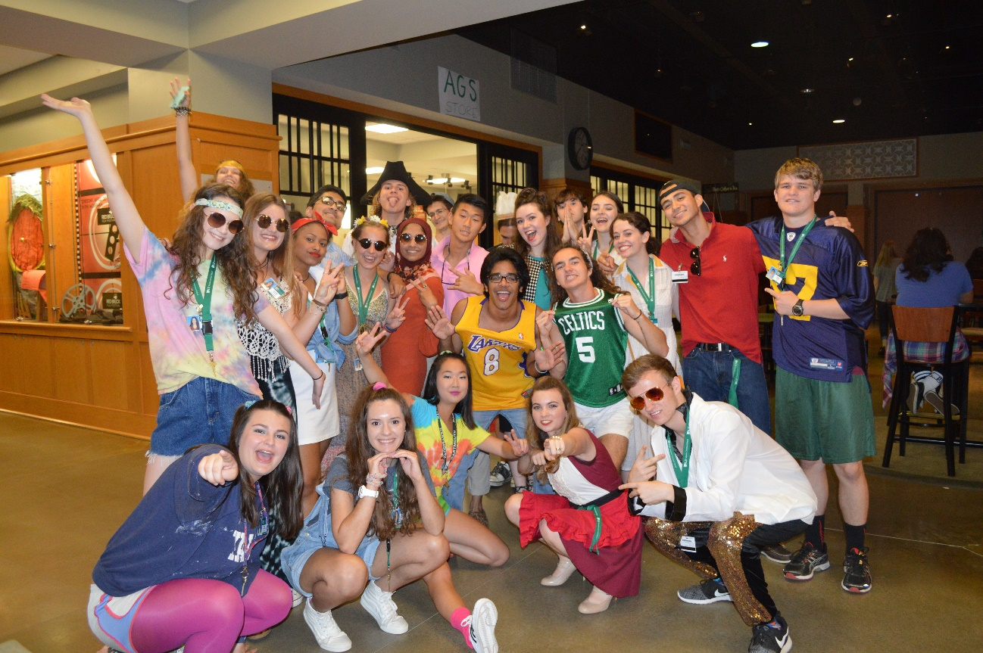
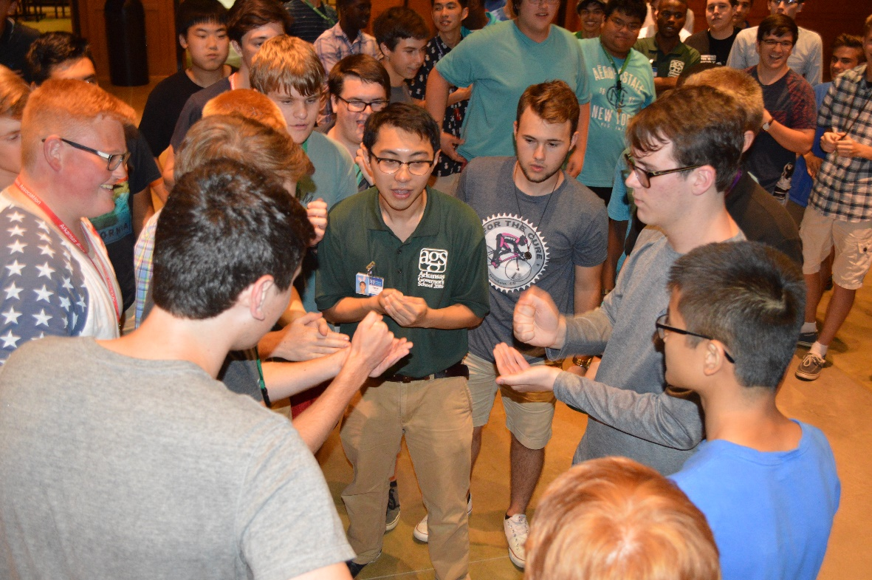
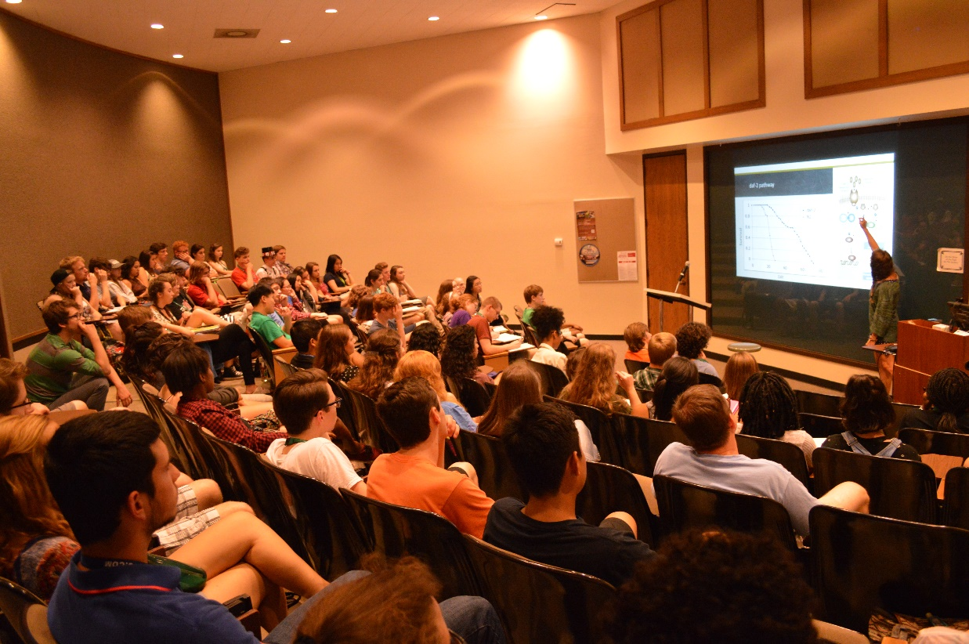
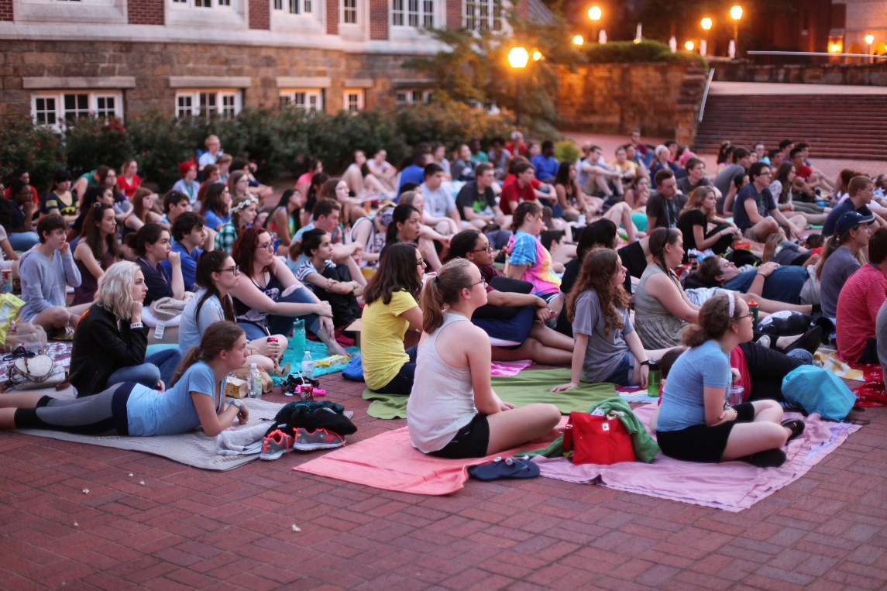

Slide 15
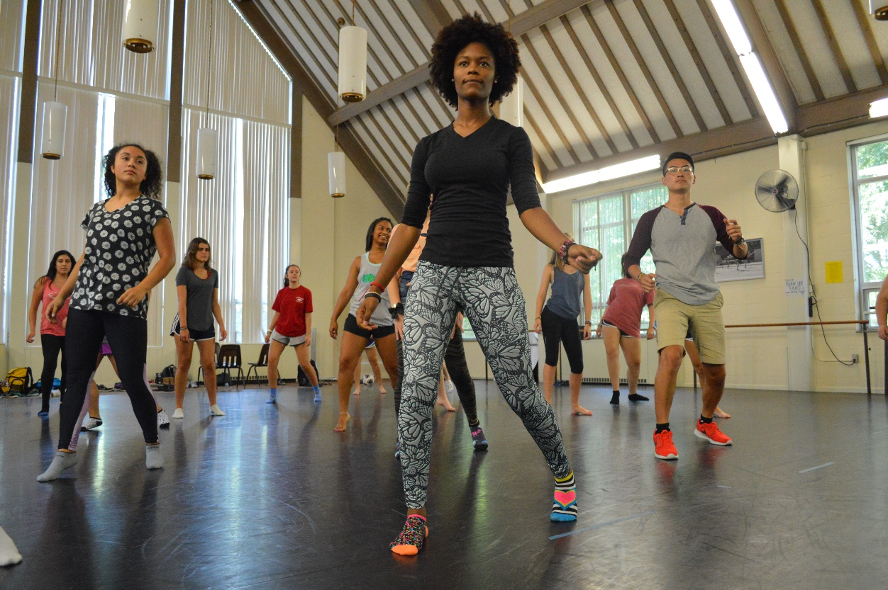
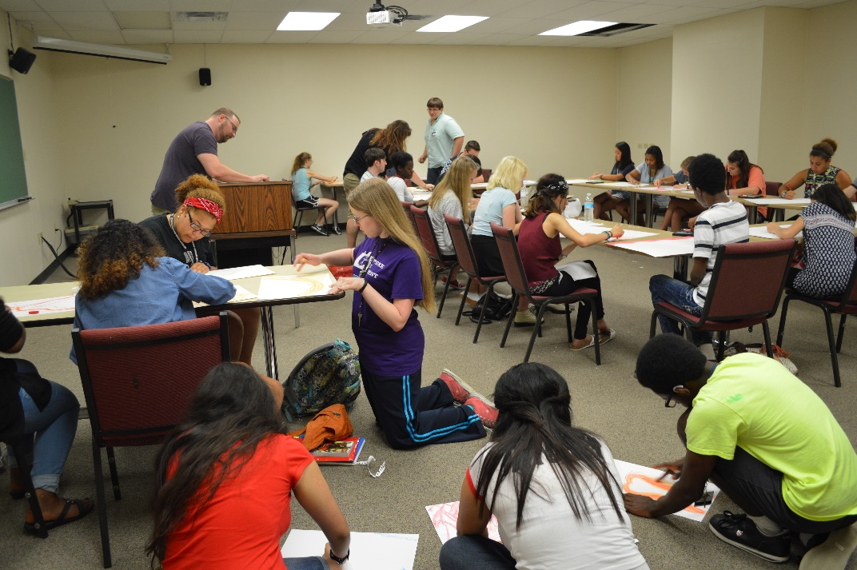

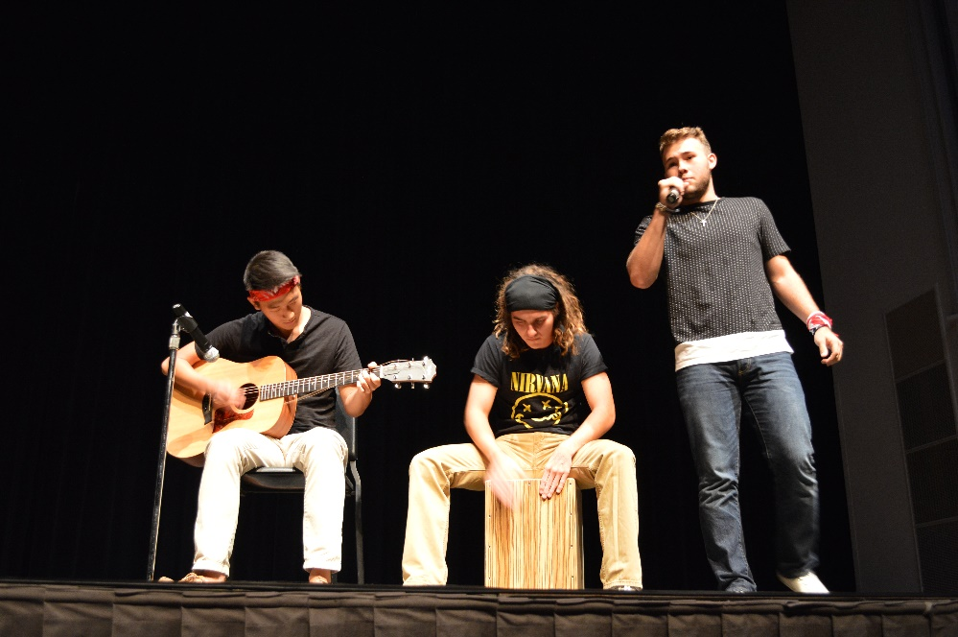

Slide 16
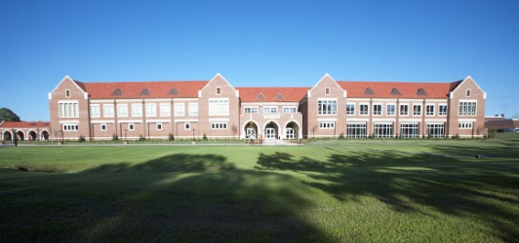
Wellness and Athletic Center (WAC)
State-of-the-art workout equipment
Indoor, professional-class pool (with a retractable roof)
Basketball, volleyball, tennis, soccer, softball, kickball, ultimate frisbee
Indoor rock wall

Slide 17
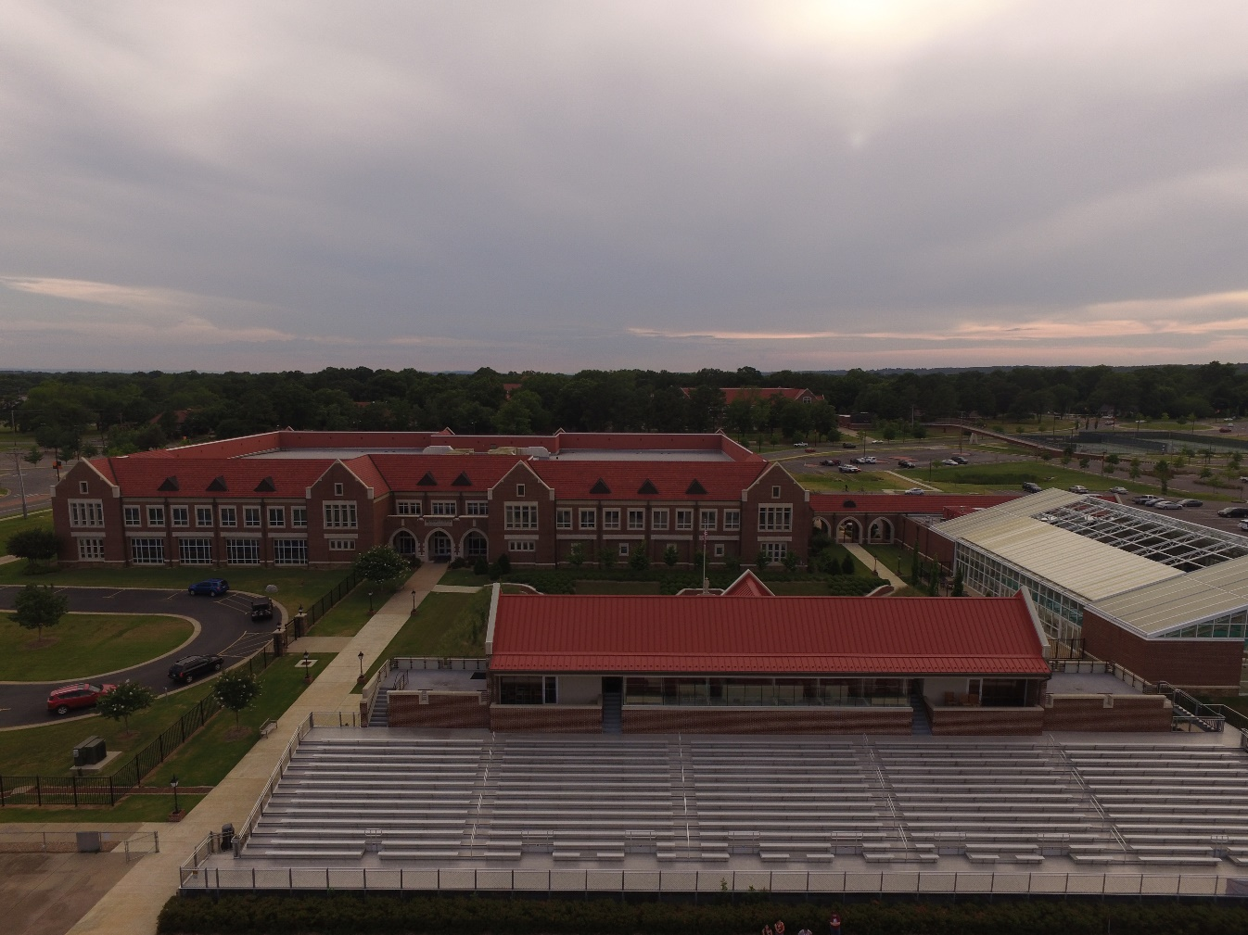

Slide 18
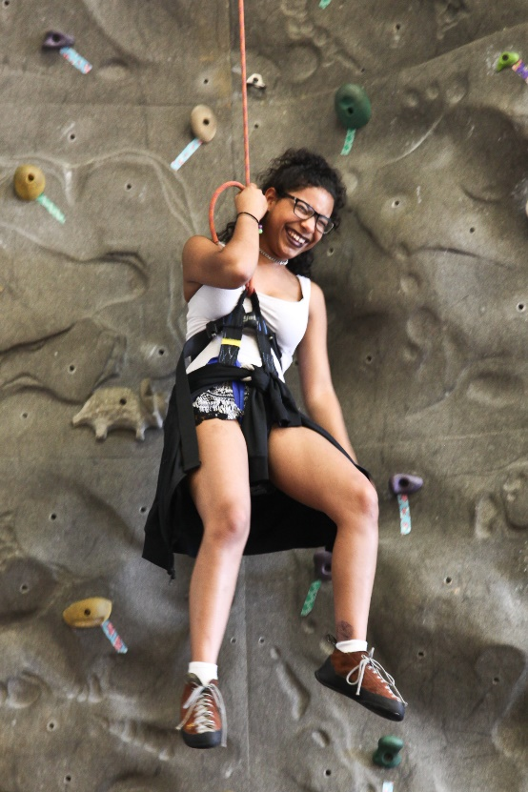
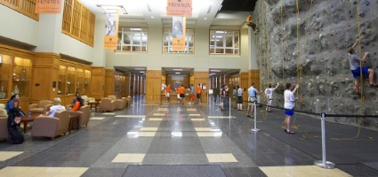
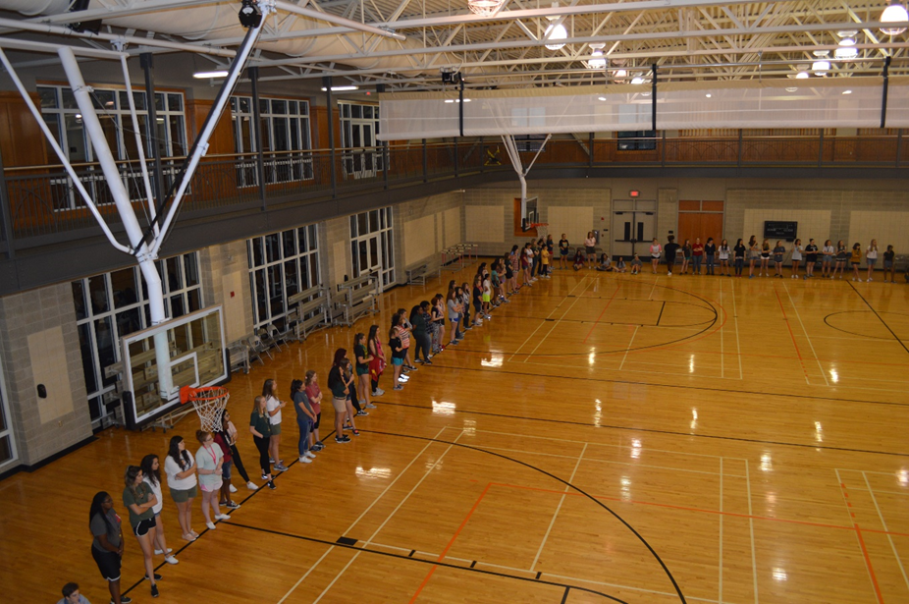
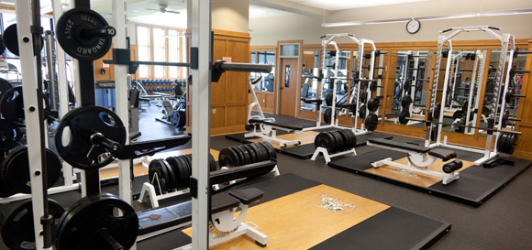
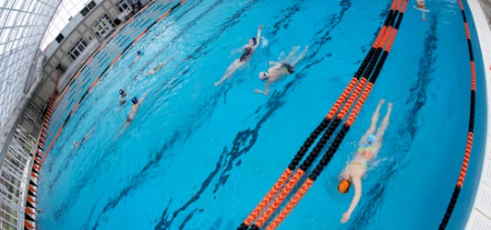

Slide 19
Student and Life Technology Center (SLTC)
Dining Hall
  Serves breakfast, lunch, and dinner
AGS Office
Burrow
  Hang out with friends and play games, pool, or table tennis
AGS Store
  Snacks, drinks, AGS merchandise, school supplies
Post Office
  individual P.O. boxes for each student

Slide 20
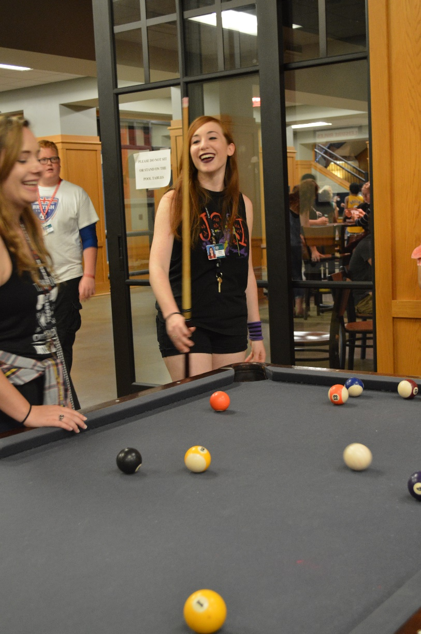
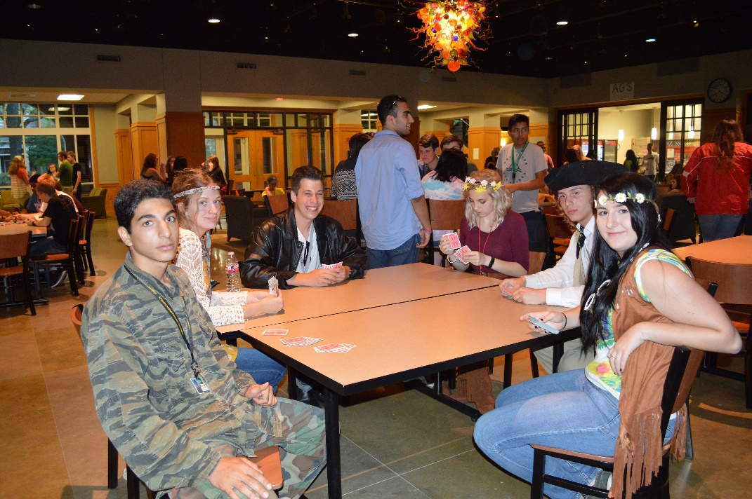
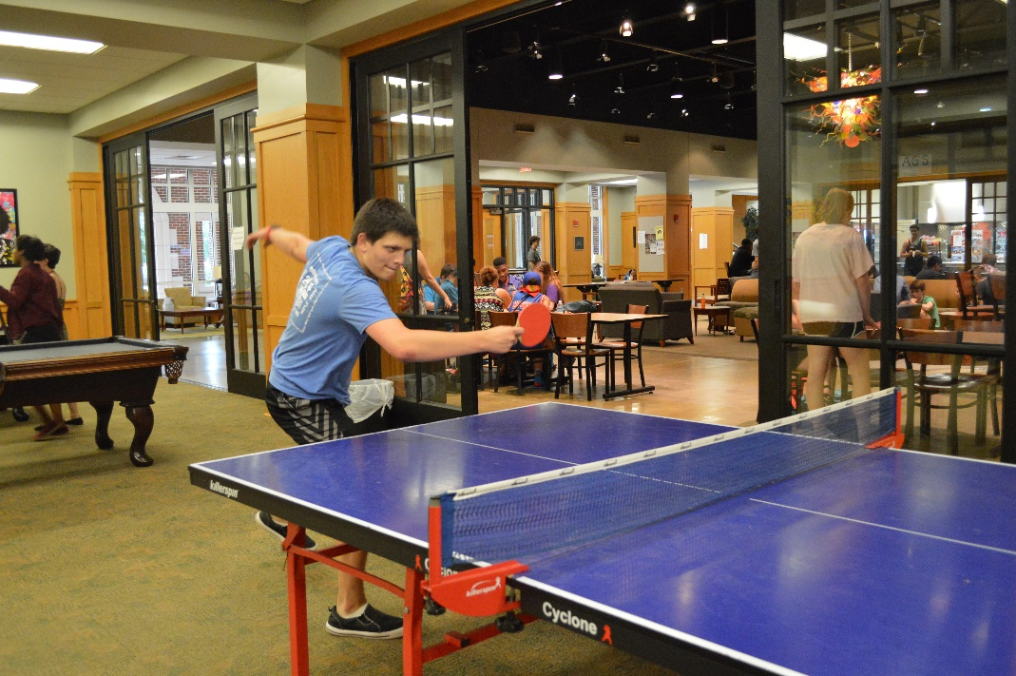

Slide 21
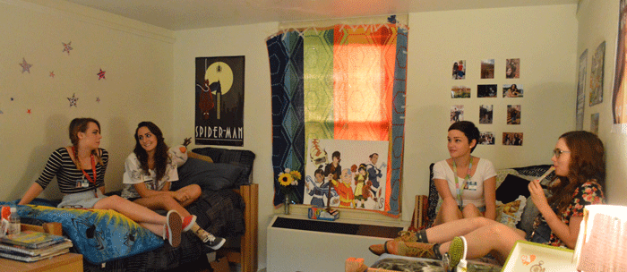
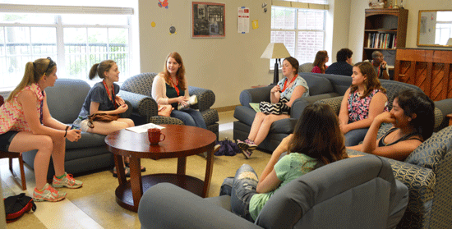
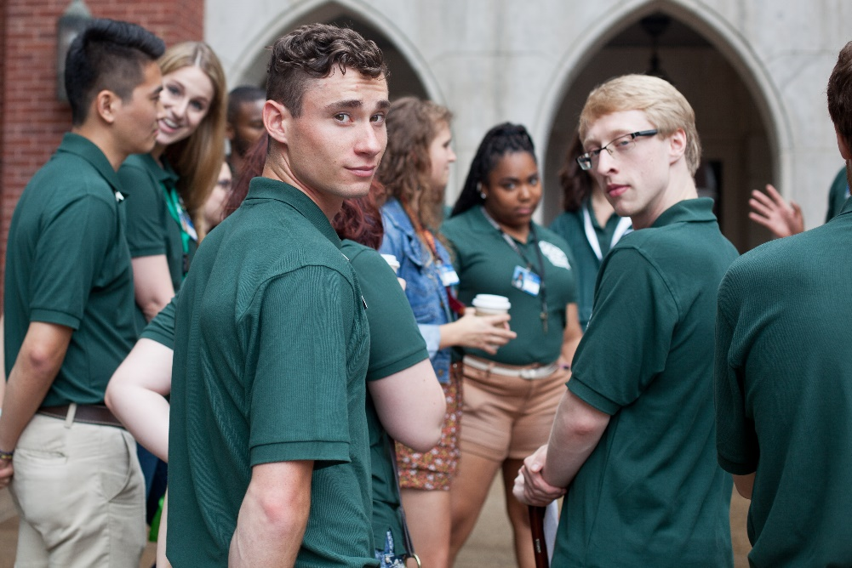
Residence Halls
Single-sex halls
Random roommate
Residential Life staff live in halls with students

Slide 22
Why Choose AGS?
Only one chance (rising high school seniors)
  “AGS was one of the greatest, most enjoyable and informative experiences of my life. I will never forget the experience, the instructors, or the students that I met during my stay.”
Is it worth the sacrifice?
  “When I was applying for AGS I was nervous that the program would not be worth the 6 weeks of my summer. After all, I could use that time to get a job or hang out with my friends. I'm happy to say that I would do AGS all over again. Heck, I'd do it 10 more times if I could. I have never been in an environment so thought provoking and open. I encourage all future students to come into the program with an open mind and be willing to challenge your ideas and beliefs. After all, if they're true you don't have anything to worry about. Anyone who is thinking about coming to AGS needs to set their summer aside for it. I have grown as a friend, as a person, and even in my faith. AGS is a wonderful program, and I have made friends that will last a lifetime.”
Can it make an impact on your life?
  “It was AWESOME. This is probably the best summer experience I have ever had. It taught me so much about critical thinking, helped me be an ethical person, and prepared me well for college. It was also really fun and I made so many new friends!!!! AGS was truly life-changing.”

Slide 23
Application Process
Students must be nominated by:
  Counselor, Teacher, GT Specialist, Administrator, Parents/Students
Nomination/application forms online
  Application and Recommendations submitted Online
  Some forms must be printed/signed and submitted to your Counselor
  Read all instructions carefully
  Due January 16, 2017 (accepted through Jan. 18 due to MLK holiday)
Schools submit all signature forms at the same time
Check the website for important dates: (https://www.hendrix.edu/ags/calendar/)

Slide 24
Application Process
Student Application
  Achievements, accomplishments, school/service projects
  Personal Essay
  May apply for up to two (2) Area I disciplines
    Area I Essay
    Teacher Recommendation
  Area I Arts applications (Choral Music, Instrumental Music, Drama, Visual Arts) must upload a video audition
  Signature Form
Excellent resource and practice for filling out college apps next year!

Slide 25
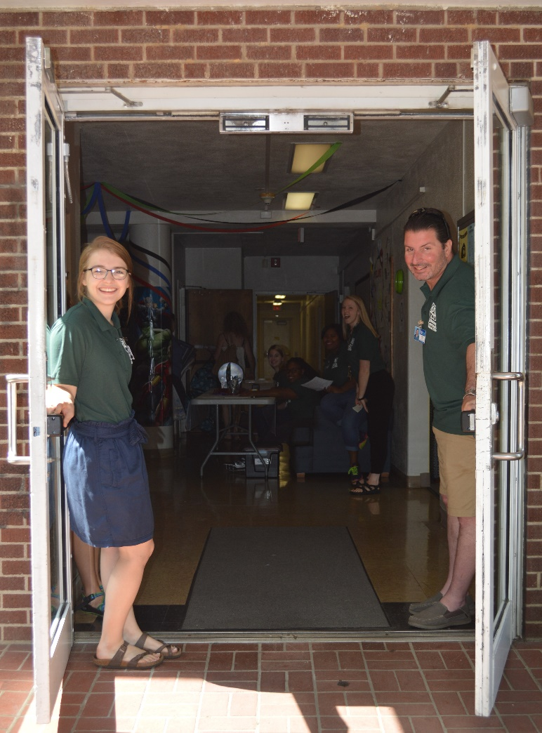
Student Application Process
Sample Student Checklist available on website
  www.hendrix.edu/ags/studentchecklist/
Student Application Required Items
  Student Application (online)
  Parent/Student Assurance Form (print/return to counselor)
  Teacher Recommendation (online)
    - One (1) for each Area I applied
  Fine Arts Audition Video (Only in Fine Arts Area I)

Slide 26
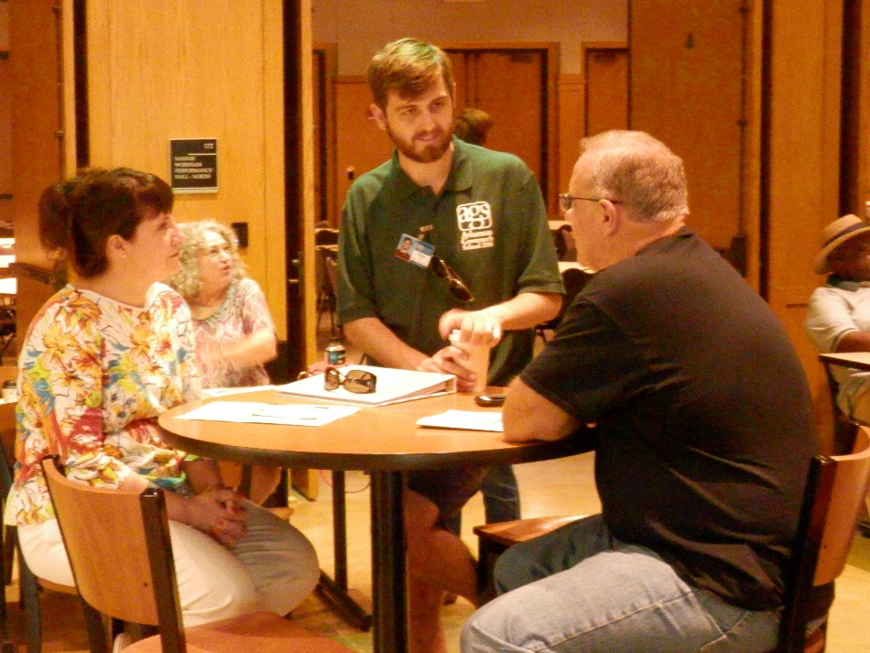
School Nomination Process
Sample School Checklist available on website
  www.hendrix.edu/ags/schoolchecklist/
School Nomination Required Items
  School Composite Form (online)
  Counselor Recommendation (online)
    - One (1) for each student applying
  School Signatures Assurance Form (print and upload/email/mail/fax)
    - One (1) for each school
    - Include Parent/Student Assurance Forms from applying students
  Transcript (Only for private, parochial, or homeschool officials)
    - Upload to Dropbox and share with mary.stein@Arkansas.gov

Slide 27
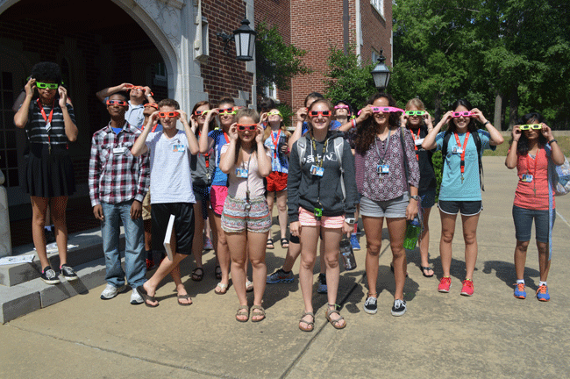
www.hendrix.edu/ags
Information about AGS (past and present)
Class descriptions
Weekly activities from past sessions
Student evaluation responses
Frequently Asked Questions
Video and photos
Faculty and Staff applications

Slide 28




Social Media
Follow AGS @ArkGovSchool on
  Facebook
  Twitter
  Instagram
Watch the AGS video on YouTube
  https://www.youtube.com/watch?v=HbrGseJSW_E

Slide 29
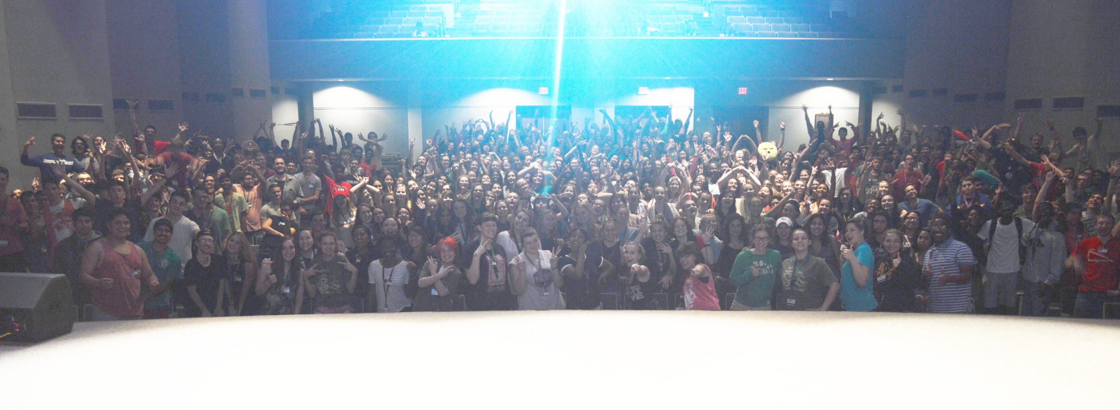
Apply to AGS!!!

